Slide 1


Presentation on User Acceptance Testing
MALAYSIA | SINGAPORE | INDONESIA | INDIA |

Slide 2

Agenda
1. What is User Acceptance Testing?
4. Why is UAT is needed
3. Who is involve in UAT
2. Purpose of UAT
5. How to conduct UAT
6. Sign-off of UAT
7. Traits of UAT Testers
Copyright © Tentacle Group, 2021|Private
2

Slide 3
What is User Acceptance Testing?
Type of testing performed by the end user or the client to verify/accept the software system before moving the software application to the production environment.
UAT is done in the final phase of testing after functional, integration and system testing is done.
Copyright © Tentacle Group, 2021|Private

Slide 4
Purpose of UAT
Purpose of UAT is to validate end to end business flow. It does not focus on cosmetic errors, spelling mistakes or system testing.
User Acceptance Testing is carried out in a separate testing environment with production-like data setup involving multiple users.
Copyright © Tentacle Group, 2021|Private

Slide 5
Who is involved in UAT
Clients
Testers simulating End Users
Business Unit
Copyright © Tentacle Group, 2021|Private

Slide 6
Why is UAT is needed
Developers might have built software based on requirements document by their own understanding and further required changes during development may not be effectively communicated to them, so for testing whether the final product is accepted by client/end-user, user acceptance testing is needed.
Developers code software based on requirements document which is their “own” understanding of the requirements and may not actually be what the client needs from the software.
Requirements changes during the course of the project may not be communicated effectively to the developers.
Copyright © Tentacle Group, 2021|Private

Slide 7
How to conduct UAT
Analysis of Requirement
UAT Plan Creation
Identify Test Scenarios
Test Case Development
Test Data Prep
Execution of Test Case
Reporting & Sign-off
Copyright © Tentacle Group, 2021|Private

Slide 8
Sign-off of UAT
Before moving into production, following needs to be considered:
No critical defects open
Business process works satisfactorily
UAT Sign off meeting with all stakeholders
Copyright © Tentacle Group, 2021|Private

Slide 9
Traits of UAT Testers
UAT Tester should possess good knowledge of the business.
He should be able to work independent or in a team.
Tester should be analytical and combine all sort of data to make the UAT successful.
Copyright © Tentacle Group, 2021|Private

Slide 10
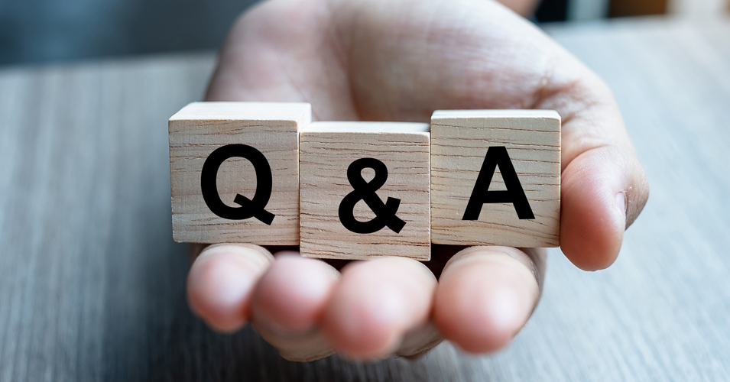
Copyright © Tentacle Group, 2021|Private

Slide 11


Reach us
Malaysia
Block 3b-09-05, Plaza Sentral, Jalan Stesen Sentral 5, 50470 Kuala Lumpur, Malaysia, Tel : +60 3 2282 1541
Block A-20-1, Menara Atlas, Plaza Pantai, No:5, Jalan 4/83a, Off Jalan Pantai Baru, 59200 Kuala Lumpur, Malaysia, Tel : +60 3 2282 1541
India
Sahas Embassy, 2
Floor, New No. 131/8, Old No. 145/8, NM Road, Chennai – 600 029
+91 44 2374 0400
sales@tentacletech.com

